Slide 1
CSE322 Formal Languages and Automation Theory
Topic: Minimization of DFA

Slide 2
Minimization of DFA- The process of reducing a given DFA to its minimal form is called as minimization of DFA. It contains the minimum number of states. The DFA in its minimal form is called as a Minimal DFA.

Slide 3
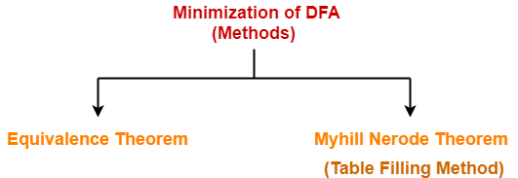
How To Minimize DFA? The two popular methods for minimizing a DFA are-

Slide 4
Minimization of DFA Using Equivalence Theorem-
Step-01:
Eliminate all the dead states and inaccessible states from the given DFA (if any).
Dead State
All those non-final states which transit to itself for all input symbols in ∑ are called as dead states.
Inaccessible State
All those states which can never be reached from the initial state are called as inaccessible states.

Slide 5
Step-02:
Draw a state transition table for the given DFA.
Transition table shows the transition of all states on all input symbols in Σ.
Step-03:
Now, start applying equivalence theorem.
Take a counter variable k and initialize it with value 0.
Divide Q (set of states) into two sets such that one set contains all the non-final states and other set contains all the final states.
This partition is called P₀.

Slide 6
Step-04:
Increment k by 1.
Find P_{k} by partitioning the different sets of P_{k-1} .
In each set of P_{k-1} , consider all the possible pair of states within each set and if the two states are distinguishable, partition the set into different sets in P_{k}.
Two states q₁ and q₂ are distinguishable in partition P_{k} for any input symbol ‘a’,
if δ (q₁, a) and δ (q₂, a) are in different sets in partition P_{k-1}.

Slide 7
Step-05:
Repeat step-04 until no change in partition occurs.
In other words, when you find P_{k} = P_{k-1}, stop.
Step-06:
All those states which belong to the same set are equivalent.
The equivalent states are merged to form a single state in the minimal DFA.
Number of states in Minimal DFA
= Number of sets in P_{k}

Slide 8
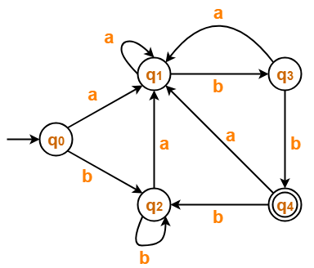
PRACTICE PROBLEMS BASED ON MINIMIZATION OF DFA- Problem-01: Minimize the given DFA-

Slide 9
Step-01: The given DFA contains no dead states and inaccessible states. Step-02: Draw a state transition table-
States | a | b
→q0 | q1 | q2
q1 | q1 | q3
q2 | q1 | q2
q3 | q1 | *q4
*q4 | q1 | q2

Slide 10
Step-03:
Now using Equivalence Theorem, we have-
P₀ = { q₀ , q₁ , q₂ , q₃ } { q₄ }
P₁ = { q₀ , q₁ , q₂ } { q₃ } { q₄ }
P₂ = { q₀ , q₂ } { q₁ } { q₃ } { q₄ }
P₃ = { q₀ , q₂ } { q₁ } { q₃ } { q₄ }
Since P₃ = P₂, so we stop.
From P₃, we infer that states q₀ and q₂ are equivalent and can be merged together.

Slide 11
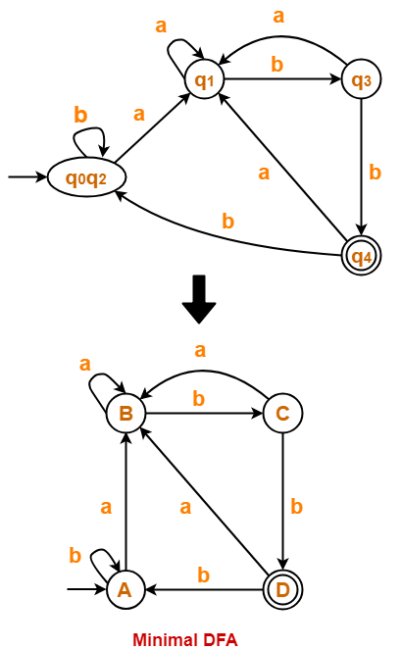
So, Our minimal DFA is-

Slide 12
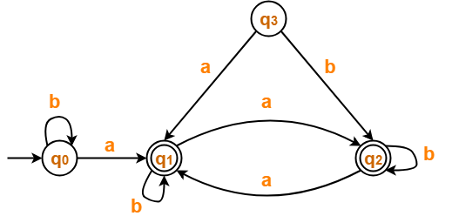
Problem-02: Minimize the given DFA-

Slide 13
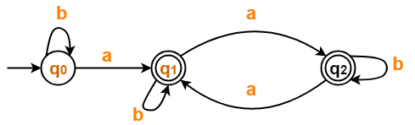
Solution- Step-01: State q₃ is inaccessible from the initial state. So, we eliminate it and its associated edges from the DFA. The resulting DFA is-

Slide 14
Step-02: Draw a state transition table-
 | a | b
→q0 | *q1 | q0
*q1 | *q2 | *q1
*q2 | *q1 | *q2

Slide 15
Step-03:
Now using Equivalence Theorem, we have-
P₀ = { q₀ } { q₁ , q₂ }
P₁ = { q₀ } { q₁ , q₂ }
Since P₁ = P₀, so we stop.
From P₁, we infer that states q₁ and q₂ are equivalent and can be merged together.

Slide 16
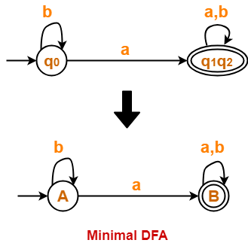
So, Our minimal DFA is-

Slide 17
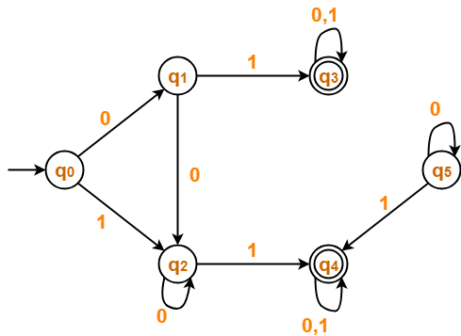
Problem # 3

Slide 18
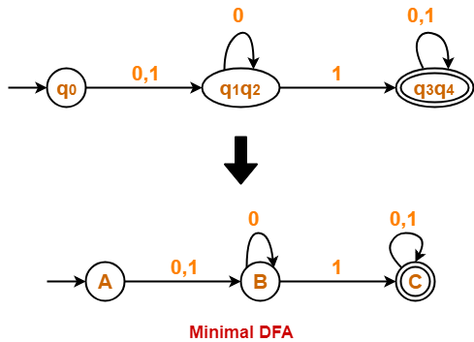
Solution of Problem # 3

Slide 19
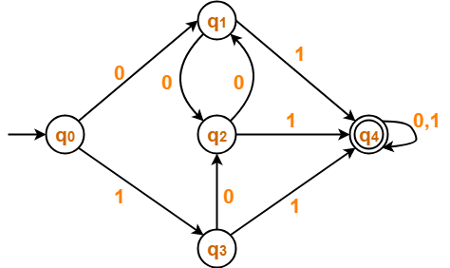
Problem # 4

Slide 20
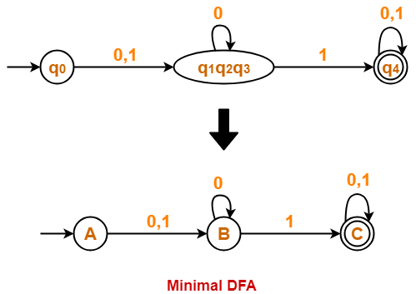
Solution of Problem No 4

